Slide 1
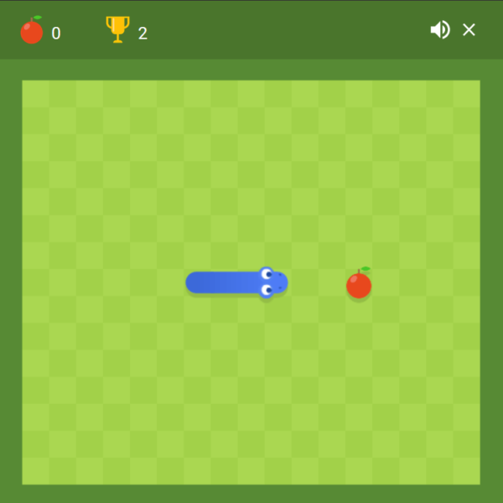
Snake Apple – funny game
Project produced by Selin Yildirim, Muhammed Mengübert Tosun, Bola Moussa, Abdelkader Jallali

Slide 2
Introduction
For what is this project/game?
Application of the game
Functionalities/ Function
Time schedule
Flowchart of algorithm and technology used
Graphical User Interface (GUI)
Demonstration
Future development plans

Slide 3

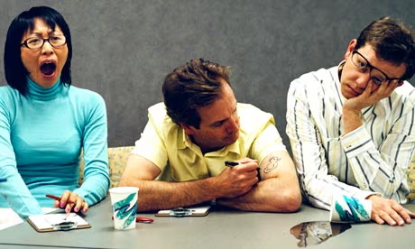
For what is this project/game?

Slide 4
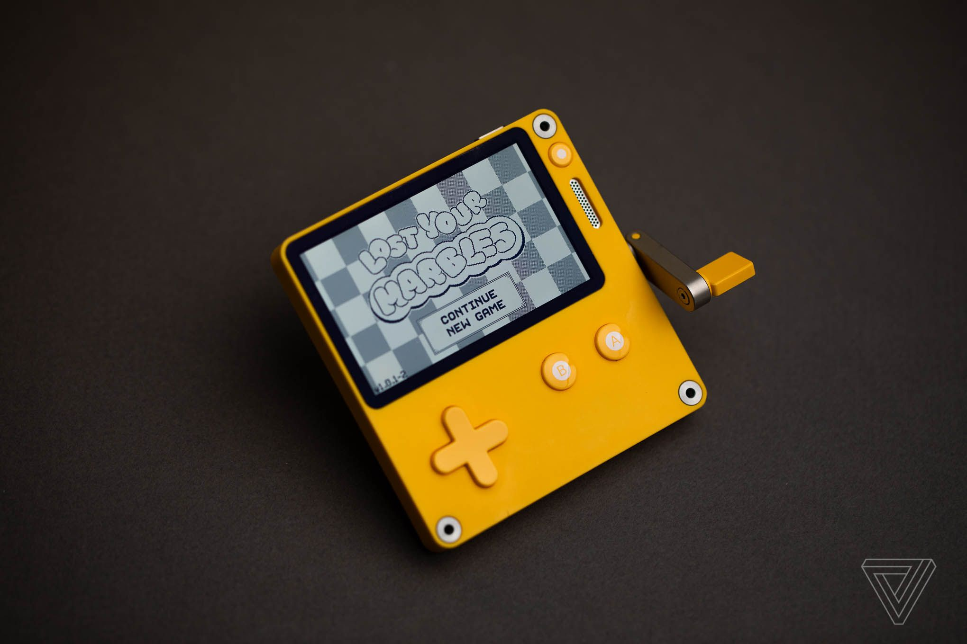

Application of the game

Slide 5
Functionalities/Function
3 main components: Snake object, Apple object and game monitoring
Snake object:
Contains information about the snake's head, its length and the entire body
Apple object:
Represents the apple that the snake can eat to earn points
Game monitoring:
Tracks the score and checks for game completion through collisions

Slide 6
Functionalities/Function
initializeGame:
Sets the starting position of the snake and the apple (random)
Sets the starting direction of the snake
drawGame:
draws all the components of the game
moveSnake:
Move the snake, Up, down, right, left initialized
updateGame:
updates and checks the game state (Lose or ate apple)

Slide 7
Time schedule
 | 01.12 - 20.12 | 25.12 – 01.01 | 01.01 – 15.01
Collected project ideas and made the final decision | Together | ---- | ----
Division of work and information collection | Together | ---- | ----
Code structure creation. How? | ---- | Abdel, Muhammed, Selin | ----
Code functions | ---- | Abdel, Muhammed, Bo | ----
Final Code creation | ---- | ---- | Muhammed, Selin
Presentation | ---- | Bo, Selin, Muhammed | Abdel, Selin, Muhammed

Slide 8


Flowchart of algorithm and technology used
Write down the individual actions of the project in a series
Test, improve and fix bugs in the code
Single function creation for targeted tasks
(using main is last method)
Testing the single functions so as not to get confused
Connecting all functions in the main with a main structure for the gameplay
final compilation of the code
Used technology:
PC and Internet help for programming
- PowerPoint, Codeblocks

Slide 9
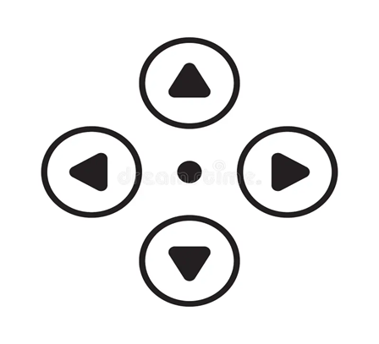
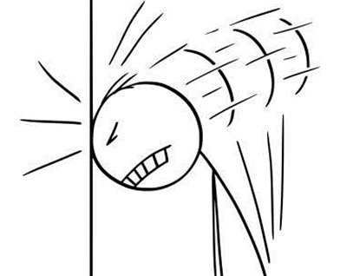
Graphical User Interface (GUI)
The GUI of the Snake game is designed to provide user-friendly, engaging gaming experience
Playing field clearly structured (#), with a clearly visible snake (from letters H→ head, B→ body), which is controlled by w, a, s, d keys
The apple is marked with letter A
In addition, score is displayed to user during the game and at the end of the round final score is displayed

Slide 10
Demonstration

Slide 11
Future development plans
Allow the player to choose different sized play areas
Ways to change skins (snake avatars)
Switch the single player mode to two player mode so that two snakes compete against each other
With very good equipment and a lot of experience, you can reprogram the 2D mode into 3D mode

Slide 12

Questions

Slide 13
Source list
https://searchengineland.com/googles-latest-easter-egg-video-game-shows-searches-snake-play-snake-283424 (Bild 1, letzter Aufruf 13.01.24)
https://www.theguardian.com/science/2011/may/06/boredom-good-for-you-claims-study (Bild 2, letzter Aufruf 13.01.24)
https://www.asaecenter.org/resources/articles/an_plus/2018/november/what-to-do-when-youre-in-the-waiting-room-of-your-career (Bild 3, letzter Aufruf 13.04.24)
https://www.theverge.com/23025390/playdate-handheld-portable-gaming-console-review (Bild 4, letzter Aufruf 13.01.24)
https://jetsonhacks.com/2016/01/09/using-codeblocks-on-jetson/ (Bild 5, letzter Aufruf 13.01.24)
https://www.dreamstime.com/game-control-video-game-controller-d-pad-icon-up-down-left-right-buttons-vector-game-control-video-game-controller-d-pad-icon-image108926933 (Bild 6, letzter Aufruf 14.01.24)
https://www.istockphoto.com/de/vektor/vektor-cartoon-illustration-von-frustrierten-mann-oder-gesch%C3%A4ftsmann-schlagen-wand-gm1254037767-366412929 (Bild 7, letzter Aufruf 13.01.24)

